Slide 1
Tirgul Hazara
SP 2023

Slide 2
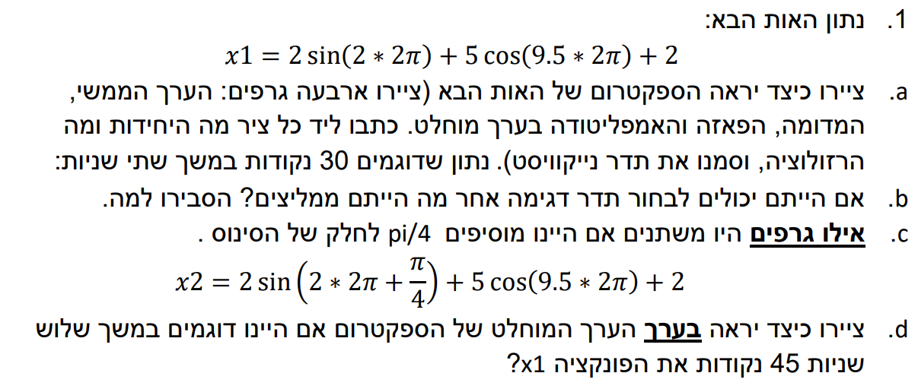

Slide 3


Slide 4


Slide 5
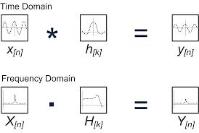
Convolution Theorem
Convolution in the time domain = multiplication in the frequency domain

Slide 6
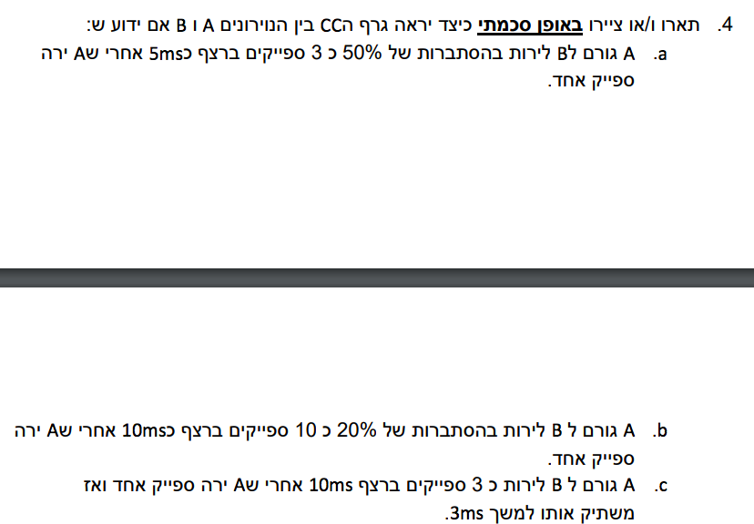

Slide 7

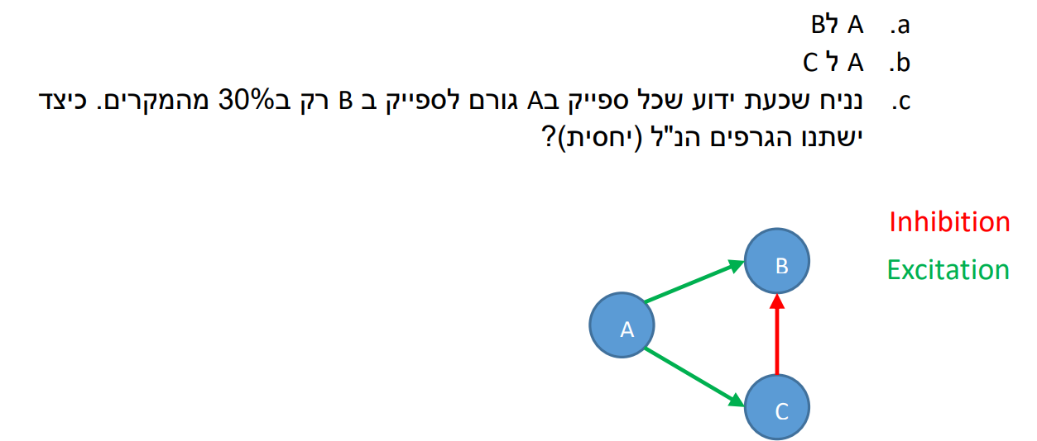

Slide 8


Slide 9
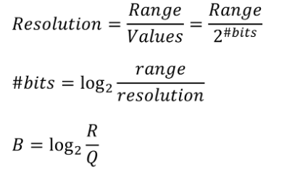



Slide 10


Slide 11
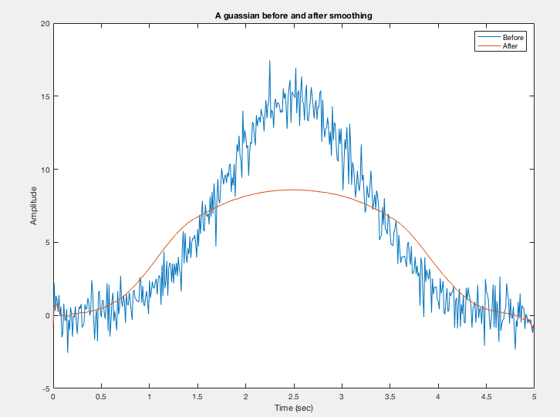
Smoothing can sometimes destroy the signal. Therefore we can only be sure about noise reduction, and not about SNR improvement.

Slide 12




Slide 13


Slide 14
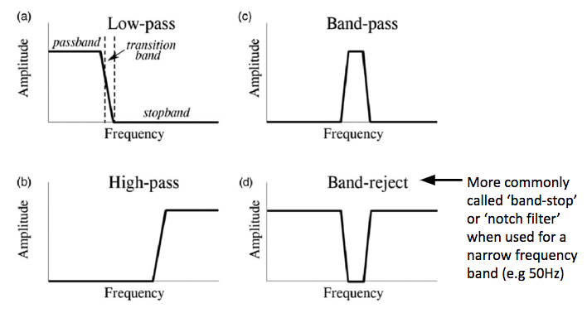
Filters

